Slide 1
Algorithm Analysis
Calculating the Cost of an Algorithm

Slide 2
How to Calculate an Algorithm’s Complexity
  To calculate the Big O for an algorithm:
    Identify the important operations & determine how often they execute
    Add the cost of each of the independent sections together
    “Filter” to remove unnecessary information
  Big O calculation has some rules:
    Analyse the worst case
    Drop constants
    Use different terms/variable names for different inputs to the algorithm
    Drop any “non-dominants”

Slide 3
Rule 1: Analyse the Worst Case
  In Big O, we want to find the WORST performance cost possible
    E.g. What is the maximum number of times a loop could run
  When calculating the cost of a line of code, think about the worst way it could play out
    for(String current: elements){
    if(current.equals(e)){
    return true;
    }
    }
    return false;
What’s the maximum number of times each of these lines would run?

Slide 4
Rule 1) Calculating…
    for(String current: elements){
    if(current.equals(e)){
    return true;
    }
    }
    return false;
O(n)
O(1)
  The loop and the if are O(n) because they will each potentially run once for every element in the array
  The returns will each only run once (O(1)), because as soon as you return from a method, the method’s code ends
    In other words, you can only ever return from a method once
  Additionally, you will only do ONE of these returns
  Total cost: O(n) + O(n) + O(1) = O(n + n + 1) = O(2n + 1)
    This leads us to rule 2 – drop your constants!

Slide 5
Rule 2) Drop Constants
  Constants: Things we know will run a fixed number of times
  We ignore/drop constants from our calculations
    These don’t impact the growth class of the algorithm
      If you have an array with 5 things, each n operations equates to 5
      If you have an array with 50000 things, each n operations equates to 50000
      A single fixed instruction doesn’t compare to this jump
  Only time we don’t drop constants is when all we have is constants!

Slide 6
Rule 2) Drop Constants (2)
  Constants can also be multipliers/coefficients
    Previous example included 2n as part of the calculation
    Multiplying by 2 doesn’t compare to increasing the number within n
      The bigger the number of elements gets, the smaller the impact the multiplier would have
  When comparing, we look at things in terms of the number of elements: An algorithm with O(n) is usually better than one with O(n²)
    O(2n) isn’t different enough from O(n) to make it worth including

Slide 7
Rule 2) Calculating…
    for(String current: elements){
    if(current.equals(e)){
    return true;
    }
    }
    return false;
All this comes to O(2n+1),
which simplifies to O(n)
  We have 2 different constant components in our current example
    2: The multiplier on our n value
    1: The single instruction
  These get dropped from our overall calculation to make it O(n)

Slide 8
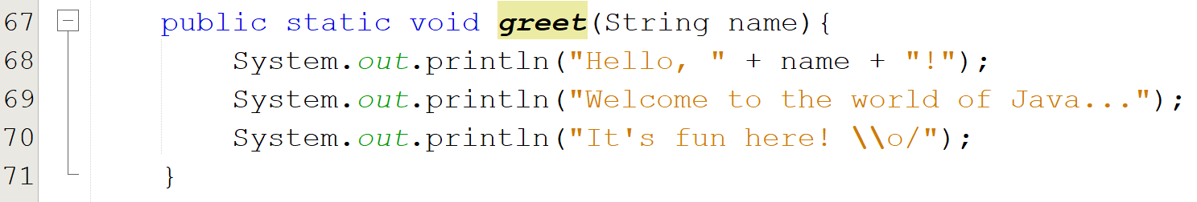
Rule 2) Calculating… (Constants Only)
  In this situation, all we have are constants
    O(1) + O(1) + O(1) = O(3)
  When we apply the “drop constants” rule, we have to simplify this
    We can’t just drop all constants, as that would imply this LITERALLY takes no time
  Simplified, this changes to O(1)

Slide 9
Rule 3) Use Different Terms for Different Inputs
  All algorithms have inputs
    If you have a single array, there is one input, giving n elements to work with
    If you have two arrays to work with, there are two inputs, giving a + b elements to work with
    If you have three arrays to work with, there are three inputs, giving a + b + c elements to work with
  If you have separate loops, you add terms
  If you have a nested loop, you multiply terms

Slide 10
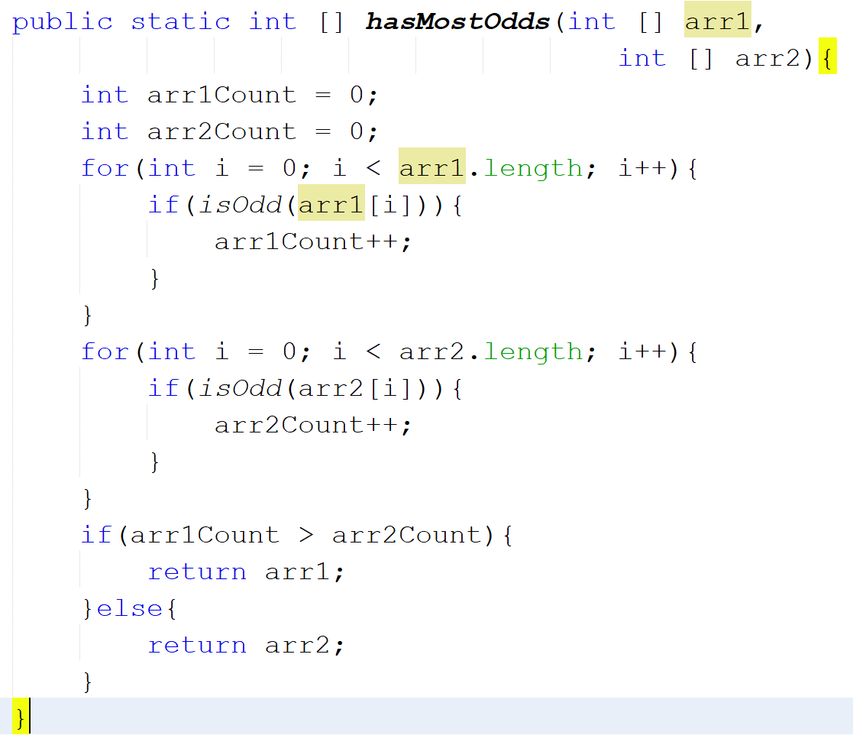
Rule 3) Calculating…
For Separate Loops With Different Terms
  In this example we have two separate loops
  For each loop in an algorithm, we add the terms involved
    Term: The number of elements in an array used by the algorithm
    Result: O(a+b), where a = arr1.length and b = arr2.length

Slide 11
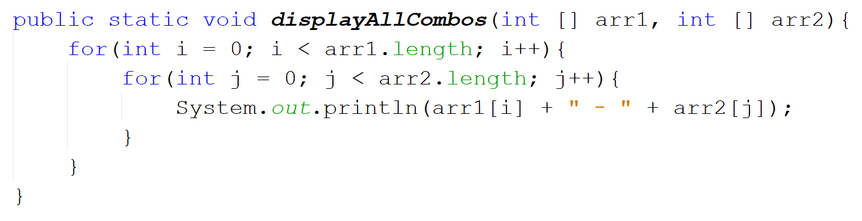
Rule 3) Calculating…
For Nested Loops With Different Terms
  In this example we have a nested loop
  To calculate a nested loop with different terms, we multiply the terms involved
    Result: O(a*b), where a = arr1.length and b = arr2.length

Slide 12
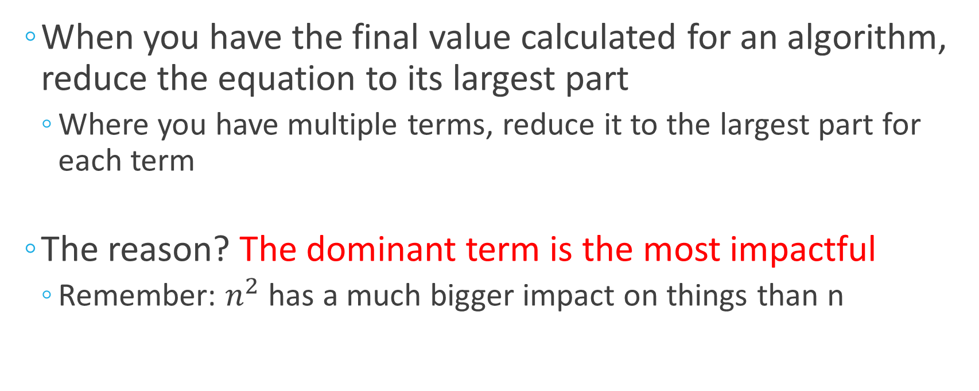
Rule 4) Remove All Non-Dominants
  When you have the final value calculated for an algorithm, reduce the equation to its largest part
    Where you have multiple terms, reduce it to the largest part for each term
  The reason? The dominant term is the most impactful
    Remember: $n^{2}$ has a much bigger impact on things than n

Slide 13
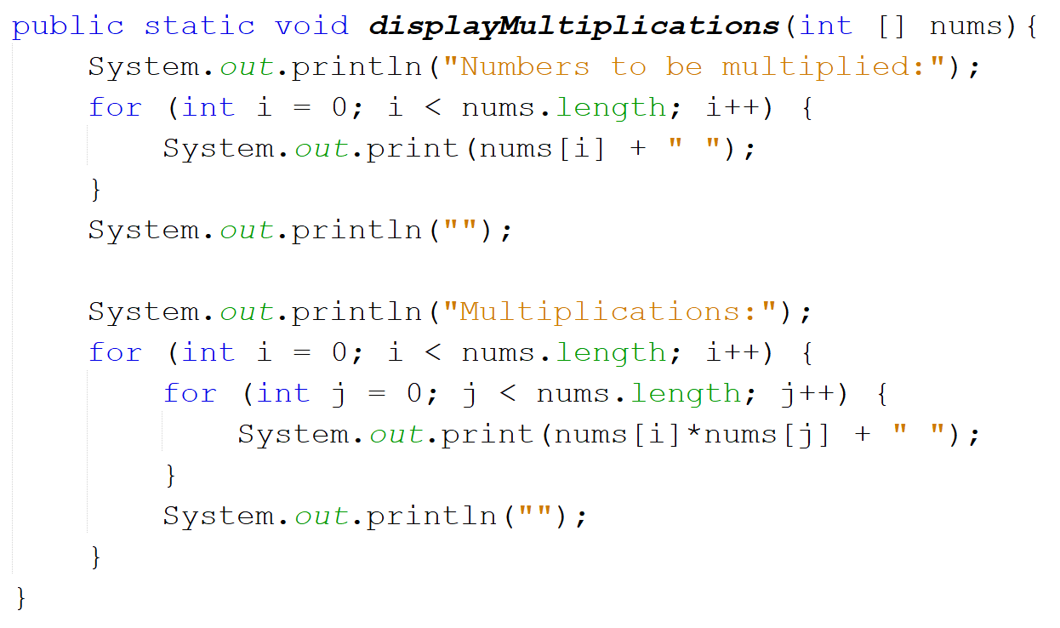
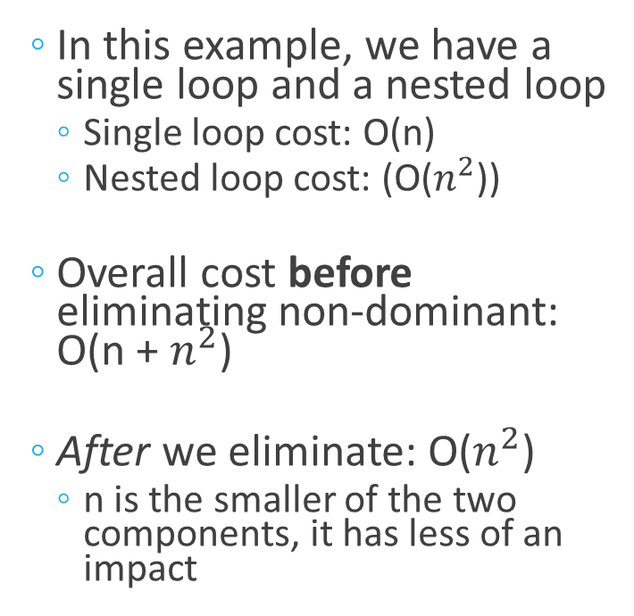
Rule 4) Calculating…
  In this example, we have a single loop and a nested loop
    Single loop cost: O(n)
    Nested loop cost: (O($n^{2}$))
  Overall cost before eliminating non-dominant: O(n + $n^{2}$)
  After we eliminate: O($n^{2}$)
    n is the smaller of the two components, it has less of an impact

Slide 14
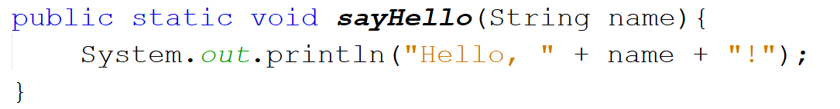
Putting the Rules into Practice:
Some Worked Examples
  Easy one to start!
  What is the complexity of this piece of code:
  Single line of code that does not repeat = O(1)
  Final Big O value: O(1)
CONSTANT

Slide 15
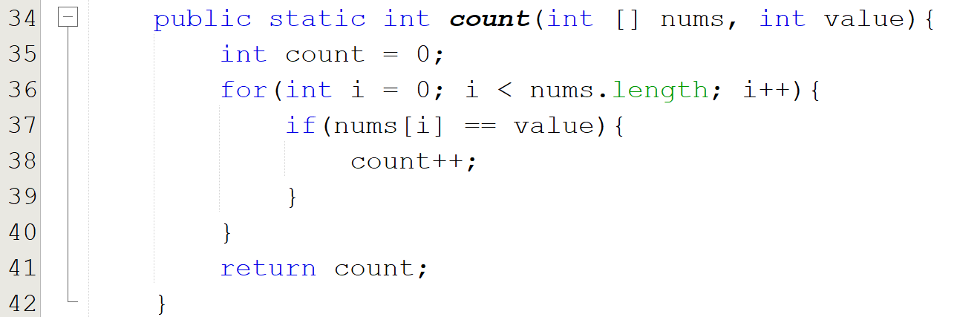
Putting the Rules into Practice:
Some Worked Examples
  What is the complexity of this piece of code:
  Line 35 = O(1)
  Line 36 = O(n)
  Line 37 = O(n)
  Line 38 = O(n)
  Line 41 = O(1)
  Initial total: O(1 + n + n + n + 1) = O(3n + 2)
  After removing constants: O(n)
    No constant multipliers – remove the 3 coefficient
    No constant values – remove the 2
LINEAR

Slide 16
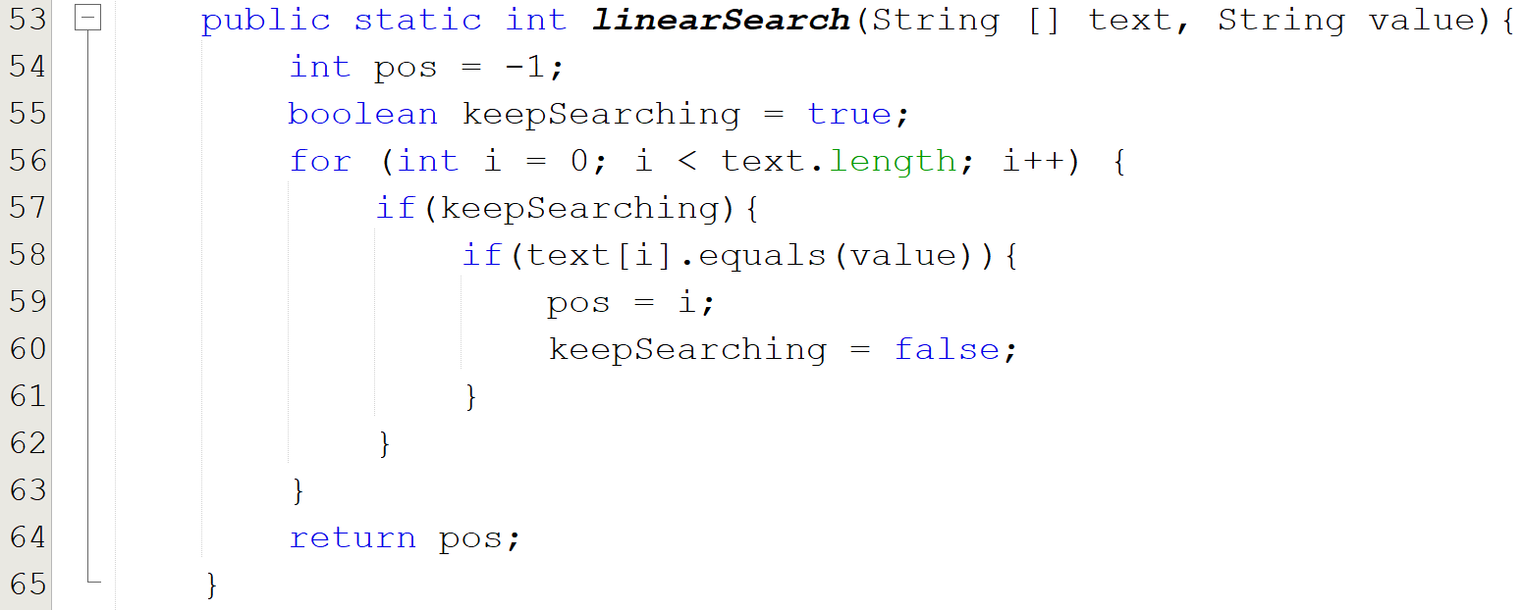
Putting the Rules into Practice:
Some Worked Examples
  What is the complexity of this piece of code:
  Line 54 = O(1)
  Line 55 = O(1)
  Line 56 = O(n)
  Line 57 = O(n)
  Line 58 = O(n)
  Line 59 = O(n)
  Line 60 = O(n)
  Line 64 = O(1)
Linear search – Approach A!
  Initial total: O(1 + 1 + n + n + n + n + n + 1) = O(5n + 3)
  After removing constants: O(n)
    Same as previous example, remove the multiplier and the constant terms
LINEAR

Slide 17
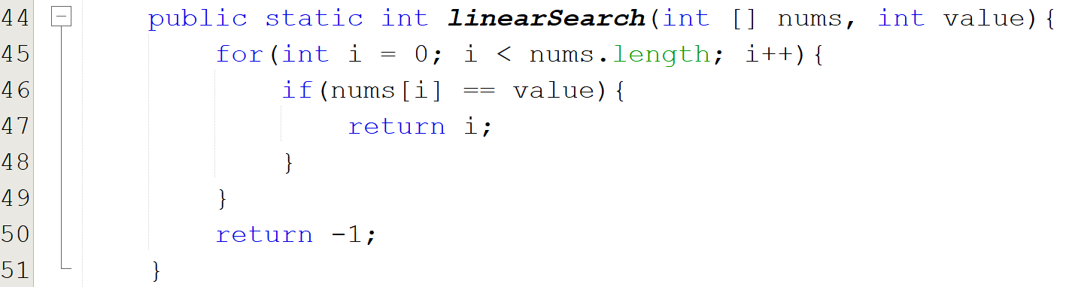
Putting the Rules into Practice:
Some Worked Examples
  What is the complexity of this piece of code:
  Line 45 = O(n)
  Line 46 = O(n)
  Line 47 = O(1)
  Line 50 = O(1)
Linear search – Approach B!
  Initial total: O(n + n + 1 + 1) = O(2n + 2)
  After removing constants: O(n)
    Same as previous example, remove the multiplier and the constant terms
  However, what can we say about the BEST case here?
LINEAR

Slide 18
What About Best Case?
  Big O notation calculates the WORST possible performance for an algorithm
  We’ve seen two versions of linear search – both have a Big O of O(n), but this is the cost for the worst cases:
    If the element isn’t in the array at all
    If the element is in the very last slot of the array
  What if the element is in the very first slot?
  What if the array is empty?

Slide 19
Linear Search A: Best Case Performance
Empty Array
  When the array is empty:
  Line 54 = 1
  Line 55 = 1
  Line 64 = 1
Linear search – Approach A!
  Total: 1 + 1 + 1 = 3 operations

Slide 20
Linear Search B: Best Case Performance
Empty Array
  When the array is empty:
  Line 45 = 1
  Line 50 = 1
  Total: 1 + 1 = 2 operations
    Not much of a difference between A and B here

Slide 21
Linear Search A: Best Case Performance
Found in First Slot
  When the match is found in the first slot of the array:
  Line 54 = 1
  Line 55 = 1
  Line 56 = n
  Line 57 = n
  Line 58 = 1
  Line 59 = 1
  Line 60 = 1
  Line 64 = 1
Linear search – Approach A!
  Total: 1 + 1 + n + n + 1 + 1 + 1 + 1 = 2n + 6 operations

Slide 22
Linear Search B: Best Case Performance
  When the match is found in the first slot of the array:
  Line 45 = 1
  Line 46 = 1
  Line 47 = 1
  Total: 1 + 1 + 1 = 3 operations
    MASSIVE difference here!

Slide 23
The Limitation of Only Considering Big O
  If you only look at the Big O, you miss out on some very important information!
  Asymptotic (Big O) costs:
    linearSearch version A: O(n)
    linearSearch version B: O(n)
  Exact best case costs:
    linearSearch A: 2n+6 operations
    linearSearch B: THREE operations!

